Slide 1
Disaster Relief Inventory Simulation: Managing Resources in Humanitarian Camps
Erhun Kundakcioglu
Cem Yarkin Yildiz
Ozyegin University
Istanbul, Turkey
Ozyegin University
Istanbul, Turkey
INFORMS Annual Meeting 2024
Seattle, WA
Notes:
Ongoing work
Funded by Turkish Science Foundation

Slide 2
Agenda
Motivation
Problem Definition
Simulation Approach
Numerical Results
Concluding Remarks

Slide 3
Agenda
Motivation
Problem Definition
Simulation Approach
Numerical Results
Concluding Remarks

Slide 4
Background
Natural disasters and conflicts displace millions of people (UNHCR, 2024)
Displaced people need to live in temporary locations for extended periods
Humanitarian organizations and governments supply aid
Under limited resources, an effective inventory management strategy is essential (Balcik, Bozkir, and Kundakcioglu, 2016)

Slide 5
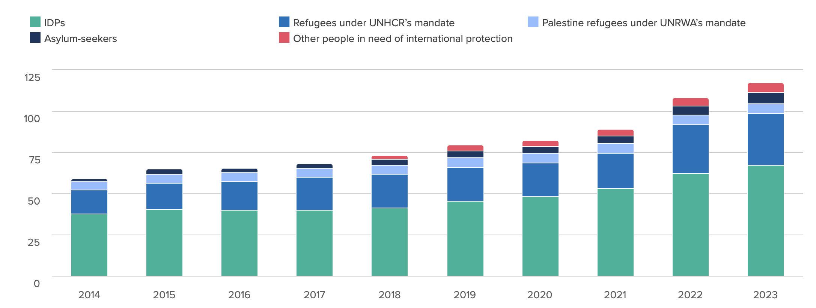
People Forcibly Displaced Worldwide
Data source: (UNHCR, 2024) https://www.unhcr.org/global-trends
Notes:
Pay attention to the increasing trend in internally displaced populations

Slide 6
Research Question
How can post-disaster inventory management be optimized across multiple camps in disaster scenarios, considering real-world factors such as perishability of goods, budget constraints, and stochastic demand?
What is the impact of funding uncertainty and migration patterns on inventory allocation decisions, and how can humanitarian organizations improve their decision-making by addressing these challenges?
How does an open-source, flexible, and modular simulation tool support the empirical testing and refinement of inventory management strategies in humanitarian relief operations?

Slide 7
Agenda
Motivation
Problem Definition
Simulation Approach
Numerical Results
Concluding Remarks

Slide 8
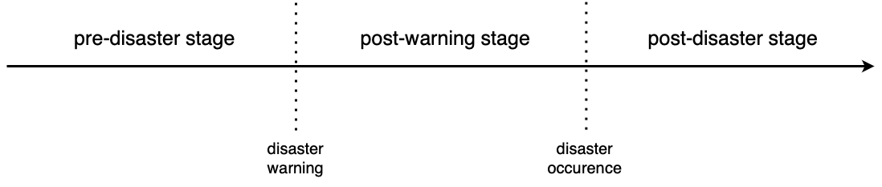
Challenge
Post-disaster inventory management
High level of uncertainty (funding, demand, migration etc.)
Various objective functions (costs, deprivation etc.)
Difficult to solve each scenario analytically
Notes:
Sudden onset events

Slide 9
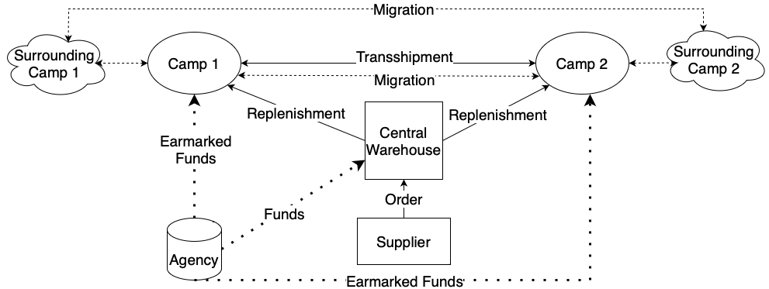
Problem Setting – Refugee Camps
Notes:
Earmarked funds are contributions that a donor allocates to a particular region, program, or activity.
Earmarked funding is especially important for underrepresented communities such as minorities.
Alignment with donor priorities – addressing specific needs (targeted aresas/programs) – better accountability/reporting – increased donor engagement
A note on in-kind donations…

Slide 10
Requirements
Multiple camps with demand patterns (sporadic, periodic, one-time)
Central warehouse to manage camp inventories
Multiple items with perishability concerns (Ferreira et al., 2018)
Camp demand: internal and external (Natarajan et al., 2017)
Control mechanism (Azizi, Bozkir, Trapp, Kundakcioglu, Kurbanzade, 2021)
In-kind/cash funding, earmarked/unearmarked (Bukart et al., 2016)

Slide 11
Requirements
Funding from multiple agencies with patterns (Bukart et al. 2016)
Migrations out of the system, into the system, or between camps
Lead time for supply, replenishment, and transshipment
Supply chain disruptions for items

Slide 12
Agenda
Motivation
Problem Definition
Simulation Approach
Numerical Results
Concluding Remarks

Slide 13
Our Contribution
Pioneering simulation engine tailored for humanitarian inventory management, adaptable to diverse scenarios
Comprehensive KPI reporting specific to humanitarian operations
Open-source (implemented in Java), offering flexibility and ease of use
High performance and modular design

Slide 14
Applications
As a decision support tool
Insights for scenarios where analytical solutions are not feasible
Sensitivity analysis for scenarios in the presence of analytical solutions

Slide 15
Potential Application Scenarios
Refugee camp management (Karsu et al., 2019)
Humanitarian relief operations
Camp management after natural disasters such as earthquake, flood, hurricane or complex emergencies
Any inventory management strategy that involves a central depot and a camp structure

Slide 16
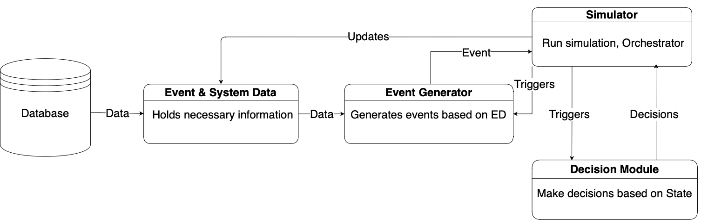
Simulation Engine – Architecture
Decisions
Replenishment
Transfer
Transshipment
Lead times
Events
Funding
Demand
Migration
Supply disruptions
Perishability of items
Notes:
Design patterns

Slide 17
Simulation Engine – Input
Yet Another Markup Language (YAML) based input mechanism
For ease of use, web-based input generation will be implemented

Slide 18
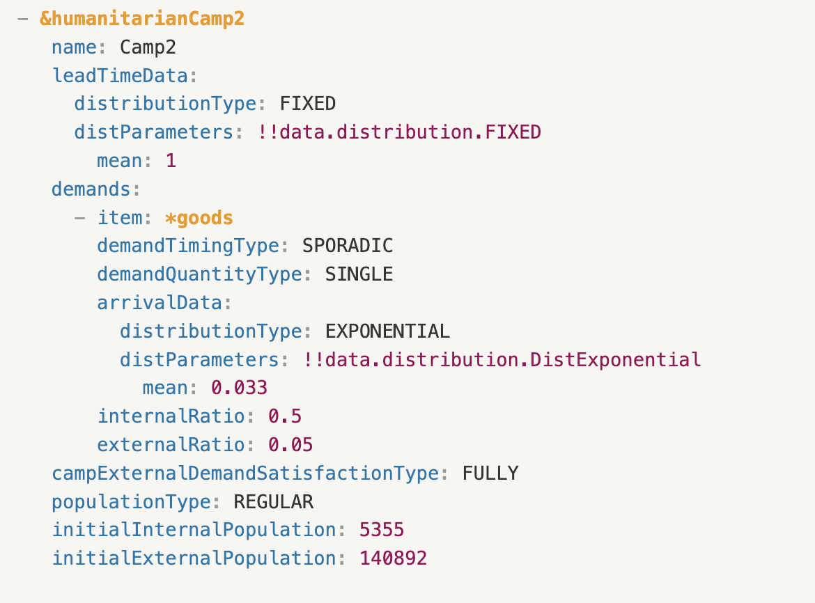
Simulation Engine – Input
Yet Another Markup Language (YAML) based input mechanism
For ease of use, web-based input generation will be implemented

Slide 19
Simulation Engine – Output
Generates an output with camp KPIs
Camp Name | Item Name | Total Purchase Cost | Total Items Used | Deprivation Cost | # of Ppl Deprived | Avg Time Deprvd | Holding Cost | Referral Cost | # of Referrals | Expired Items
Kilis | HygieneKit | 1,205,455 | 241,091 | 9,871 | 77,427 | 2.28 | 1,215,348 | 189,120 | 94,560 | 0
Kilis | Medicine | 585,336 | 48,778 | 4,526 | 16,309 | 2.25 | 238,920 | 78,456 | 19,614 | 0
Hatay-2 | HygieneKit | 1,029,780 | 205,956 | 3,060 | 24,000 | 2.2 | 1,437,303 | 210,164 | 105,082 | 0
Hatay-2 | Medicine | 502,488 | 41,874 | 1,416 | 5,099 | 2.17 | 286,104 | 88,612 | 22,153 | 0
Osmaniye | HygieneKit | 1,114,370 | 222,874 | 28,031 | 218,640 | 5.22 | 22,885 | 131,058 | 65,529 | 0
Osmaniye | Medicine | 541,872 | 45,156 | 12,884 | 45,079 | 6.29 | 1,410 | 55,128 | 13,782 | 0
Hatay-3 | HygieneKit | 1,157,275 | 231,455 | 5,550 | 43,534 | 2.29 | 1,439,124 | 227,552 | 113,776 | 0
Hatay-3 | Medicine | 563,988 | 46,999 | 2,558 | 9,214 | 2.3 | 288,876 | 90,596 | 22,649 | 0
Hatay-1 | HygieneKit | 973,080 | 194,616 | 1,912 | 14,993 | 2.08 | 1,437,512 | 205,480 | 102,740 | 0
Hatay-1 | Medicine | 472,524 | 39,377 | 810 | 2,917 | 2.02 | 293,467 | 79,400 | 19,850 | 0
Adana | HygieneKit | 2,854,900 | 570,980 | 25,881 | 203,010 | 2.18 | 2,693,845 | 426,784 | 213,392 | 0
Adana | Medicine | 1,398,852 | 116,571 | 11,510 | 41,465 | 2.13 | 544,637 | 171,396 | 42,849 | 0

Slide 20
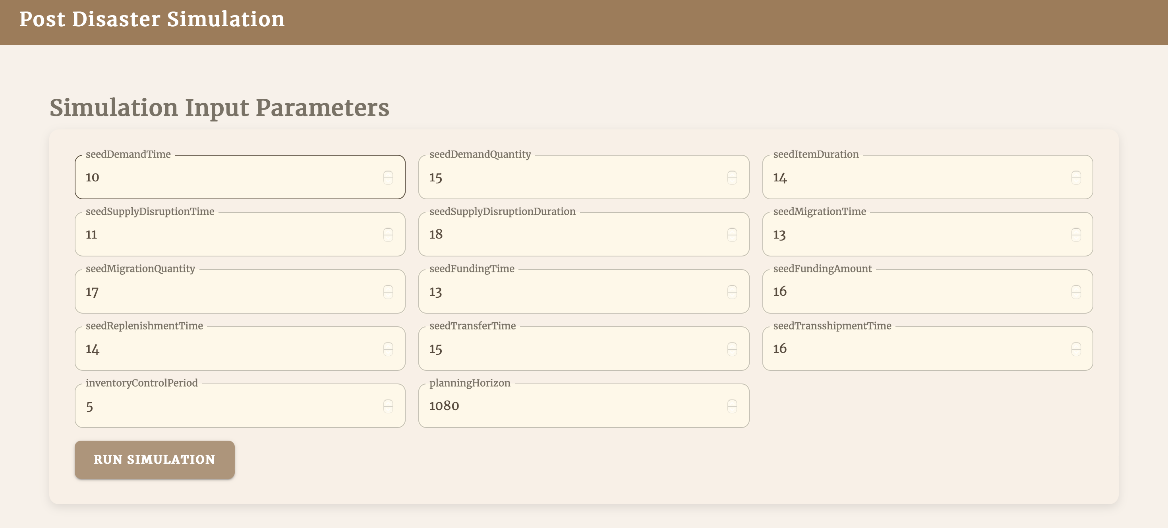
Simulation Engine UI

Slide 21
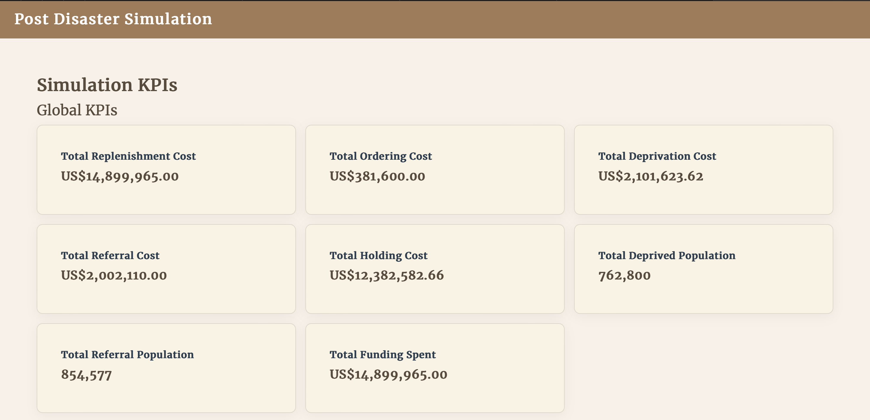
Simulation Engine UI

Slide 22
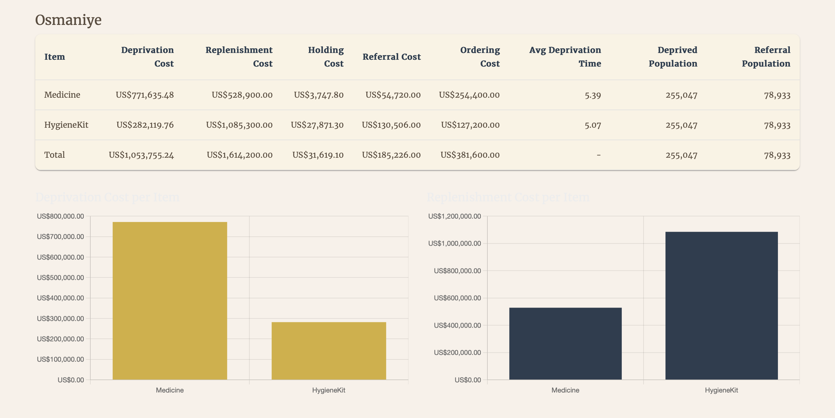
Simulation Engine UI

Slide 23
Agenda
Motivation
Problem Definition
Simulation Approach
Numerical Results
Concluding Remarks

Slide 24
Sample Problem
2 items
7 camps (internal and external demand)
If depleted, internal demand backlogged
time dependent exponential deprivation
Referral for external demand under threshold

Slide 25
Problem Parameters
Length of Simulation: 1080 days (3 years)
Median is assumed 4 by UNHCR
Claimed to be overestimated (Devictor et al., 2016)
Types of Items:
Medicine (Perishable)
Shelf life: Uniform 30–60 days.
Hygiene Kit (Non-perishable)

Slide 26
Problem Parameters
The aim is to simulate one critical/expensive and one less critical item
Ordering Costs:
Hygiene Kits: $1200
Medicine: $2400
Purchase Costs:
Hygiene Kits: $5
Medicine: $12

Slide 27
Problem Parameters
Each Camp Resident:
20% for medicine
25% for hygiene kits
Each Resident Outside Camp:
2% for medicine
2.5% for hygiene kits
Demand Arrivals: Follow exponential interarrival times

Slide 28
Problem Parameters
Deprivation Cost: One year of holding cost equals to
24 days of internal shortage (deprivation) for medicine
48 days of deprivation for hygiene kits
External Demand Rejection (Referral) Cost:
Medicine: Holding for 4 days
Hygiene Kits: Holding for 2 days
Holding Cost: $1 per unit per day for both items

Slide 29
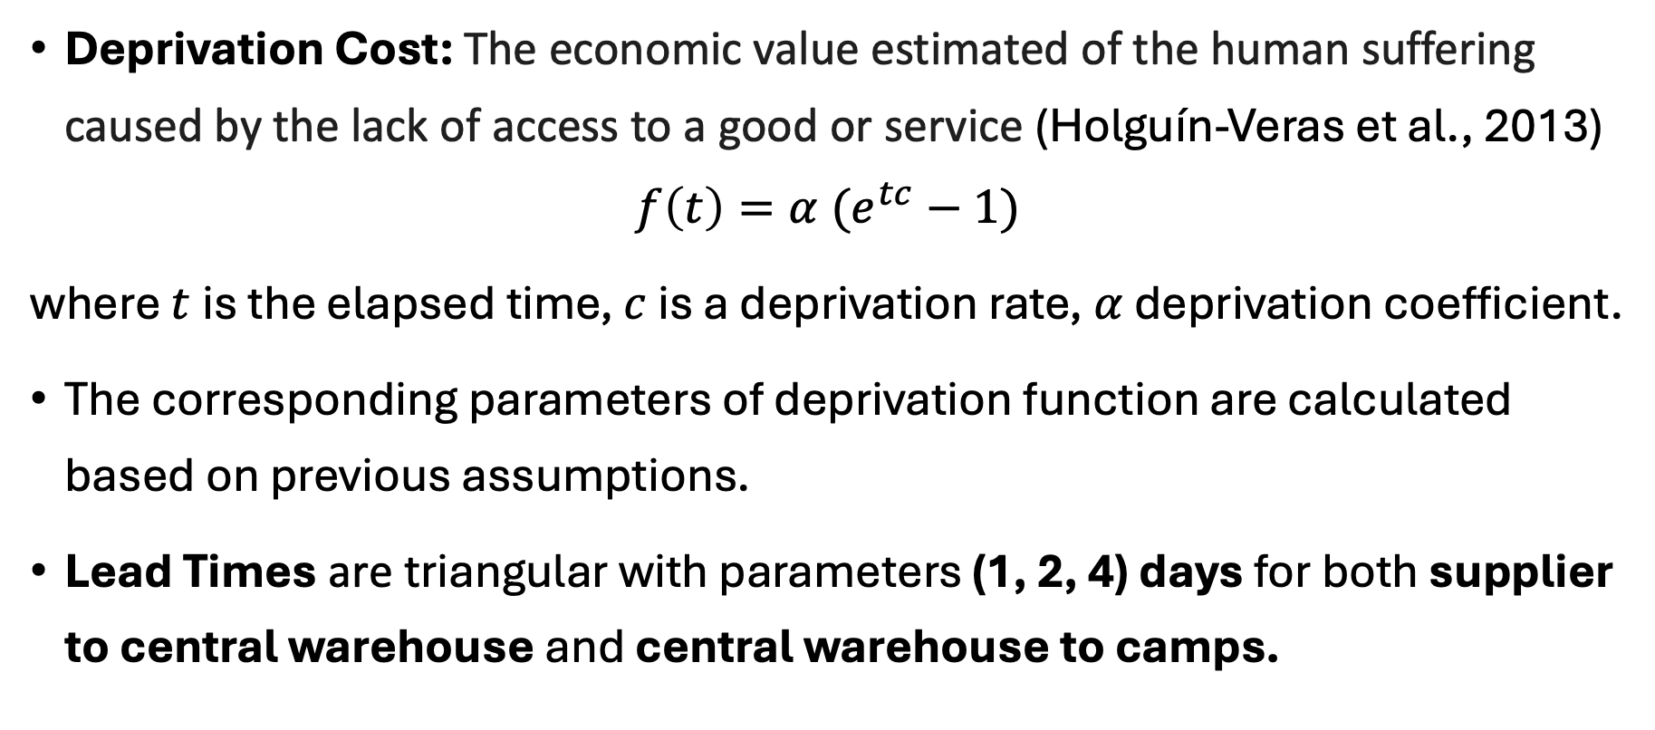
Problem Parameters
Deprivation Cost: The economic value estimated of the human suffering caused by the lack of access to a good or service (Holguín-Veras et al., 2013)
$$f\left(t\right)=α (e^{tc}−1)$$
where $t$is the elapsed time, $c$ is a deprivation rate, $α$ deprivation coefficient.
The corresponding parameters of deprivation function are calculated based on previous assumptions.
Lead Times are triangular with parameters (1, 2, 4) days for both supplier to central warehouse and central warehouse to camps.

Slide 30
Analyses Conducted
Replenishment cycle length for (s, S) policy
Effect of budget
Sensitivity to funding arrivals
Effect of stochastic arrival of funds
Adjusting reorder point and order-up-to-level
To appear in (Yildiz and Kundakcioglu, 2024)

Slide 31
Replenishment Cycle Length for (s, S) Policy
Notes:
”Fixed” ordering cost

Slide 32
Effect of Budget

Slide 33
Sensitivity to Funding Arrivals

Slide 34
Effect of Stochastic Arrival of Funding

Slide 35
Adjusting reorder point and order-up-to-level

Slide 36
Agenda
Motivation
Problem Definition
Simulation Approach
Numerical Results
Concluding Remarks

Slide 37
Concluding Remarks
For the same amount of funding:
Decreased funding frequency → prioritize external demand
Equally spaced fund arrivals → lower deprivation costs
Early loaded fund → inefficient spending

Slide 38
Concluding Remarks
Implementing effective sharing mechanisms instead of complete sharing across demand groups
Beyond a certain threshold, the marginal impact of each additional dollar diminishes
Higher replenishment frequency and lower s,S levels preferred
Funding arrival pattern is more influential than minor underfunding

Slide 39

Thank you
Q&A
github.com/OEKundakcioglu/PostDisasterSimulation
Supported by the Scientific and Technological Research Council of Turkey (TUBITAK) grant 122M839.
C. Y. Yildiz and O. E. Kundakcioglu. "Disaster Relief Inventory Simulation: Managing Resources in Humanitarian Camps." Proceedings of the 2024 INFORMS Winter Simulation Conference, 2024.

